Slide 1

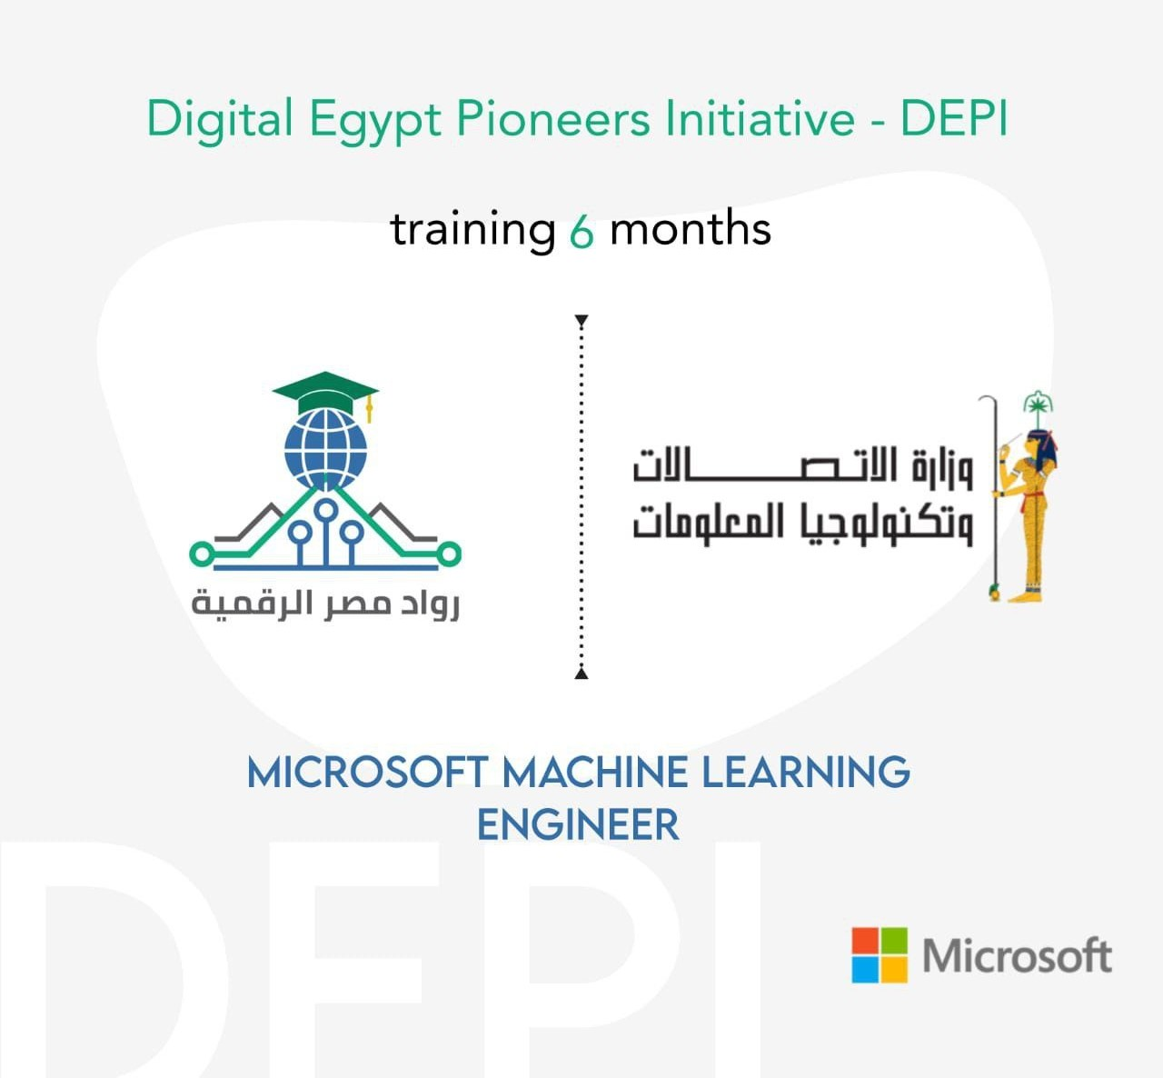
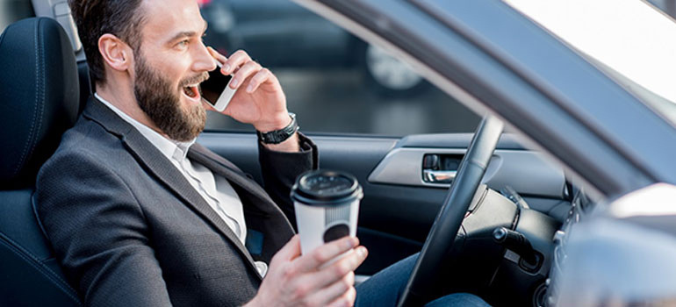
State Farm Distracted Driver Detection
Presentation By Mostafa & Hossam
Supervised By : Eng. Aya Hesham
Page 01/15
GitHub Repo

Slide 2
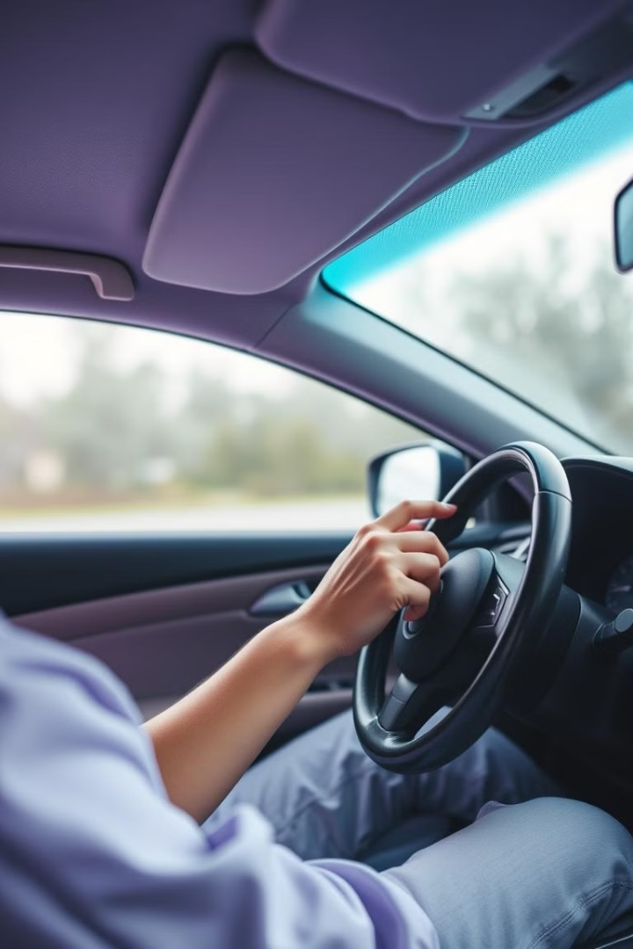
About The Project State Farm Distracted Driver Detection
Given a dataset of 2D dashboard camera images, an algorithm needs to be developed to classify each driver's behavior and determine whether they are driving attentively, wearing their seatbelt, taking a selfie with their friends in the backseat, etc. This can then be used to automatically detect drivers engaging in distracted behaviors from dashboard cameras.
Page 02/15
GitHub Repo

Slide 3
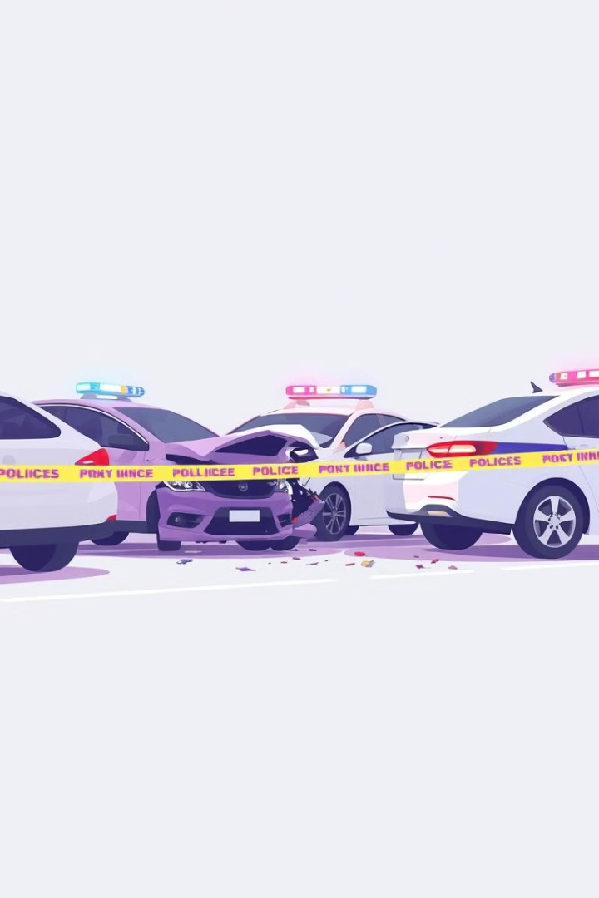
Problem Statement: Reducing Accidents Caused by Distracted Driving
1
Alarming Accident Rates
2
Diverse Distractions
Drivers can be distracted by texting, making phone calls, reaching for objects, and more.
Distracted driving is a leading cause of accidents, leading to injuries and fatalities every year.
3
Urgent Need for Solutions
Innovative technology is required to detect and prevent distracted driving behaviors in real-time.
Page 03/15
GitHub Repo

Slide 4

About the Dataset
The provided data set has driver images, each taken in a car with a driver doing something in the car (texting, eating, talking on the phone, makeup, reaching behind, etc.). This dataset is obtained from Kaggle.
The 10 classes to predict are:
c0: safe driving - c1: texting - right - c2: talking on the phone - right
c3: texting - left - c4: talking on the phone - left
c5: operating the radio - c6: drinking - c7: reaching behind
c8: hair and makeup - c9: talking to passenger
Page 04/15
GitHub Repo

Slide 5
The Distracted Driver Dataset
The dataset covers 10 distinct driver behaviors, including safe driving, texting, phone calls, operating the radio, drinking, reaching, hair and makeup, and talking to passengers.
Each behavior is represented by a labeled class in the dataset, providing a comprehensive set of examples for developing and evaluating distracted driving detection algorithms.
The images are captured from dashboard cameras, offering a clear view of the driver's actions and surroundings during various driving scenarios.
Detailed annotations and a diverse range of examples make this dataset a valuable resource for researchers and developers working on solutions to the critical issue of distracted driving.
Page 05/15
GitHub Repo

Slide 6
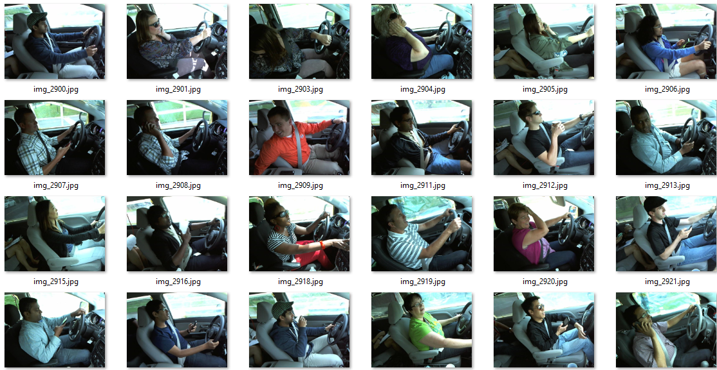
Dataset: 2D Dashboard Camera Images
Comprehensive Capture
Varied Scenarios
The dataset includes 2D images from dashboard cameras, providing a clear view of the driver's behavior.
The images cover a range of driving conditions, lighting, and distracted behaviors.
Detailed Annotations
AI-Ready Format
The dataset includes labeled examples of safe and distracted driving behaviors.
The images are in a format suitable for training and testing machine learning models.
Page 06/15
GitHub Repo

Slide 7
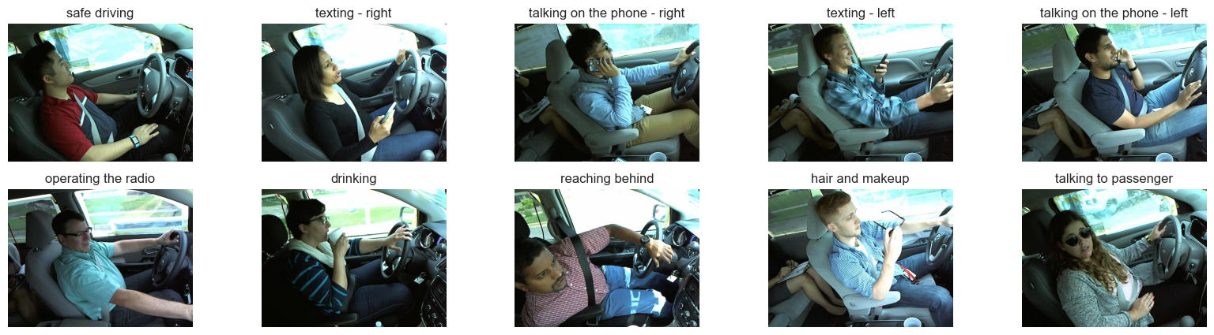
Sample of our Dataset & Class
Page 07/15
GitHub Repo

Slide 8
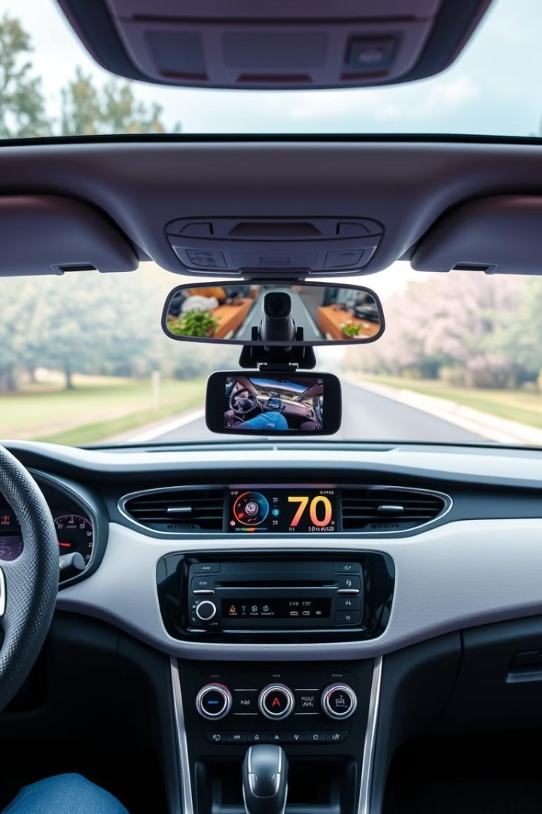



Integrating with Dashboard Cameras
Real-Time Monitoring
The algorithm will continuously analyze footage from dashboard cameras.
Instant Alerts
The system will immediately notify drivers and authorities of detected distracted behaviors.
Seamless Integration
The solution will be designed to work seamlessly with existing dashboard camera systems.
Page 08/15
GitHub Repo

Slide 9

Methodology: Image Classification Algorithm
Data Preprocessing
Model Evaluation
Normalize and augment the dataset to improve model performance.
Validate the model's accuracy on a held-out test set.
1
2
3
Model Training
Leverage convolutional neural networks to classify driver behavior.
Page 09/15
GitHub Repo

Slide 10

The Model
We use the pre-trained yolov8n-cls.pt model for classification.
The yolov8n-cls.pt model is the nano version of the YOLOv8 classification model, which is smaller and faster
Page 10/15
GitHub Repo

Slide 11
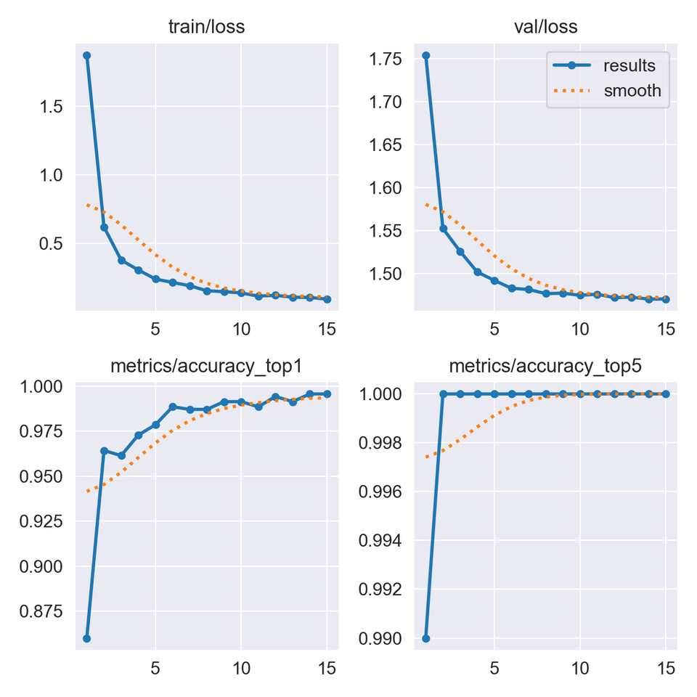
Accuracy and Loss Curves
Page 11/15
GitHub Repo

Slide 12
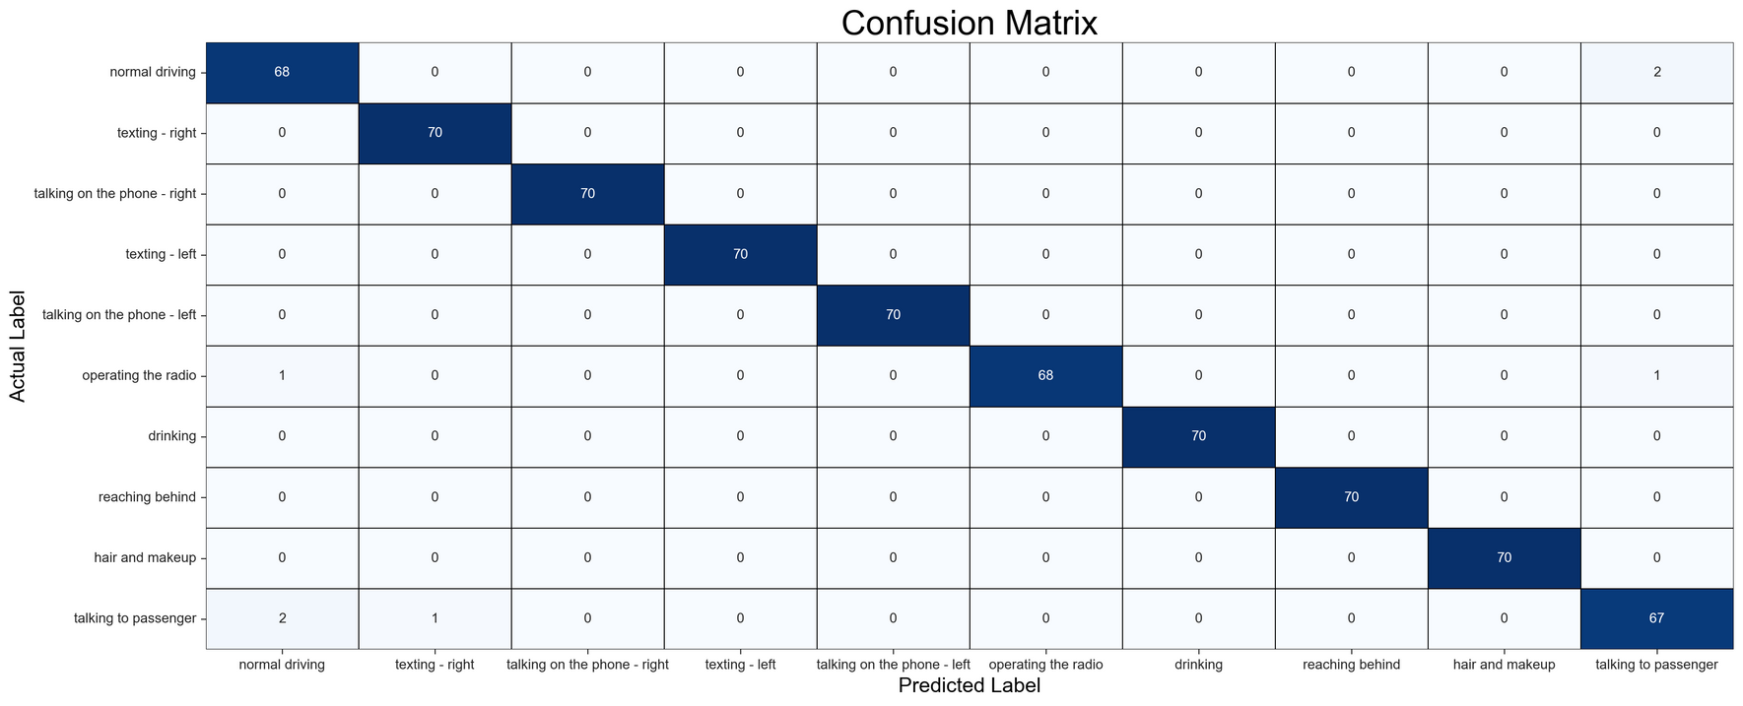
Confusion Matrix For Testing
Page 12/09
GitHub Repo

Slide 13
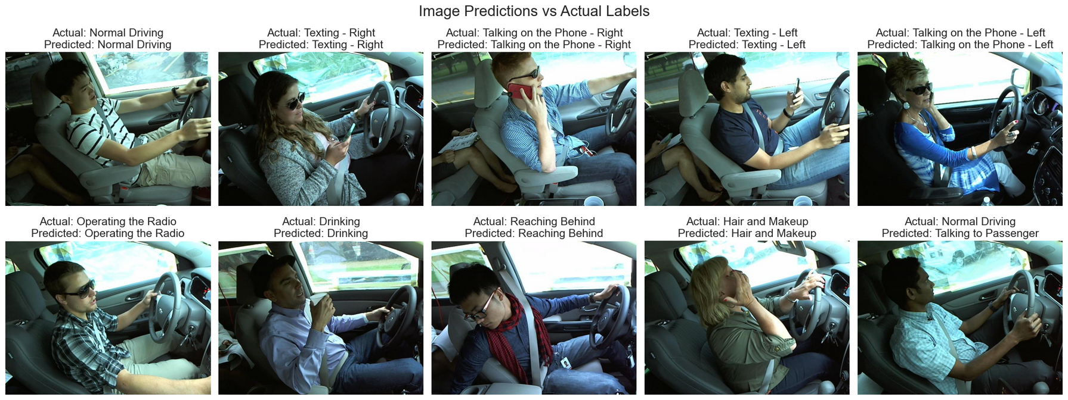
Predict Images
Page 13/09
GitHub Repo

Slide 14

Conclusion and Next Steps
1
Proven Technology
2
Scalable Solution
3
Ongoing Development
The image classification algorithm has been validated on the dataset, demonstrating high accuracy.
The system can be easily integrated with existing dashboard camera infrastructure.
Further research and testing will continue to refine the algorithm and expand its capabilities.
Page 14/15
GitHub Repo

Slide 15
Thank you
Presented By Mostafa & Hossam
Page 15/15
GitHub Repo

